Slide 1
LINUX PRIVILEGE ESCALATION AUTOMATION TOOLKIT
Detection-Based Security Auditing Tool
BY: U M MOHAMED YUSUF SHERIFF
DATE: JAN 03/02/2026

Slide 2
INTRODUCTION
Linux systems are widely used in servers and enterprises.
Misconfigurations can allow privilege escalation.
Privilege escalation = normal user gaining root access.
Manual auditing is time-consuming and error-prone.
This project develops an automated detection toolkit.

Slide 3
PROJECT OBJECTIVES
Develop an automated Linux privilege escalation scanner.
Identify real-world misconfigurations safely.
Simulate red-team enumeration techniques.
Generate structured security audit reports.
Ensure detection-only (no exploitation).

Slide 4
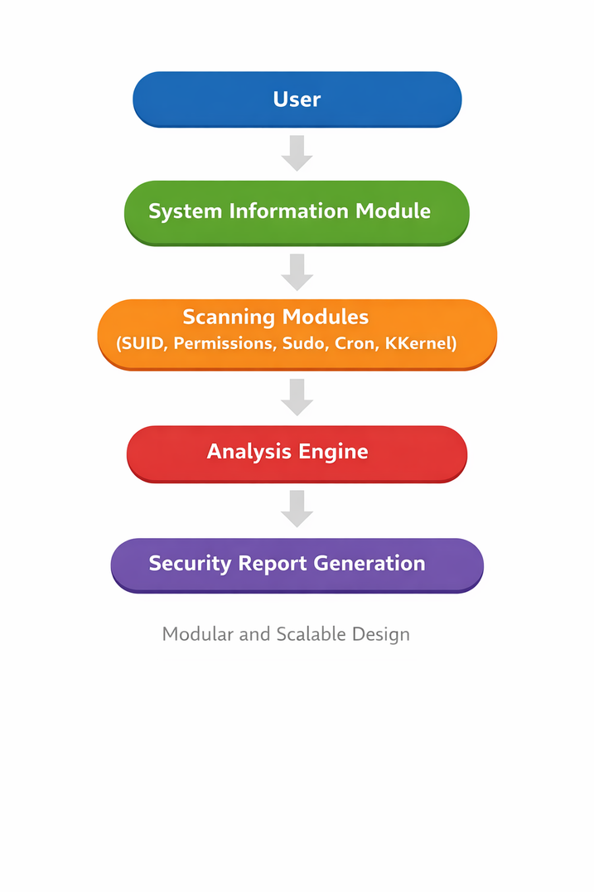
TOOLKIT ARCHITECTURE

Slide 5
MODULES IMPLEMENTED
System Information Collection
User, groups, kernel version
SUID Binary Scanner
Detects privileged executables
World-Writable File Scanner
Finds weak file permissions
Sudo Configuration Check
Identifies dangerous privileges
5.Cron Job Scanner
Detects scheduled task risks
6.Kernel Version Detection
Used for vulnerability reference

Slide 6
PRACTICAL TESTING RESULTS
SUID binaries detected successfully.
Several world-writable files identified.
User had full sudo privileges.
Cron jobs properly secured.
Kernel version extracted correctly.
Toolkit successfully generated a structured security report.

Slide 7
RISK ANALYSIS
High Risk:
Unrestricted sudo access (if unintended)
Medium Risk:
Potentially exploitable SUID binaries
Low Risk:
Secure cron configurations
Informational:
Kernel version reporting

Slide 8
CONCLUSION & LEARNING OUTCOMES
Developed automated security auditing toolkit.
Gained practical experience in Linux privilege escalation detection.
Understood red-team and blue-team methodologies.
Learned modular scripting using Python.
Improved cybersecurity reporting skills.

